Slide 1
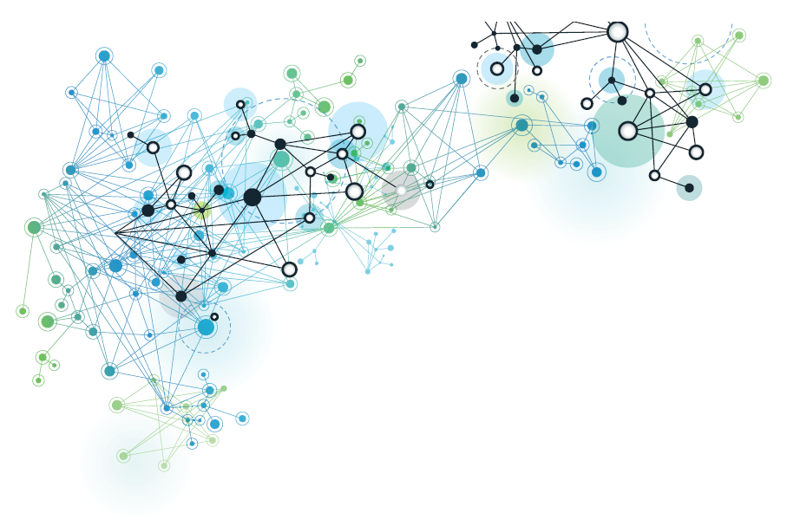


Measuring and managing corruption risks in public procurement.
Lessons from around the globe
Mihály Fazekas
University of Cambridge and Government Transparency Institute
misi.fazekas@gmail.com
High level Workshop on Corruption Measurement, G7, Rome, 23/10/2017
This project has received funding from the European Union’s Horizon 2020 research and innovation Programme under grant agreement No 645852

Slide 2
Two key messages
Corruption can be proxied objectively
  Many good and replicable corruption proxies exist, but they need to be tailored to context
We know what works and what doesn’t
While considerable evidence gaps remain. Plus effective solutions are deeply political and hard to sustain

Slide 3
Why worry about public procurement?
~Third of government spending
Links to quality of institutions, development
Lots of data globally
Very corrupt

Slide 4
I. Corruption proxies

Slide 5
Conceptualizing public procurement corruption indicators
Tendering Risk Indicators (TRI)
Contracting body
Supplier
Contract
Particularistic tie
Contracting Body Risk Indicators (CBRI)
Supplier Risk Indicators (SRI)
Political Connections Indicators (PCI)
Notes:
5-20 tested indicators in each group

Slide 6
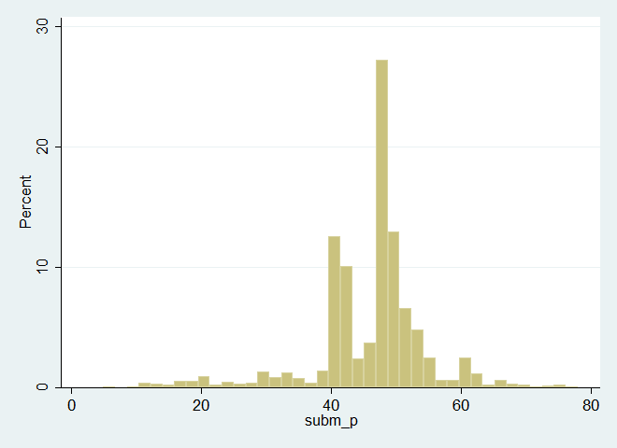
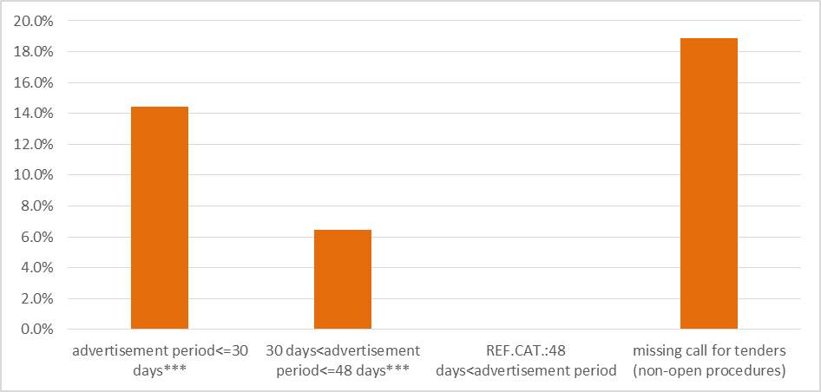
Modelling corrupt contracting: single bidding
Distribution of contracts according to the advertisement period
Tight deadline
Probability of single bid submitted for contracts compared with the market norm of 48+ days
Single bidding
Source: EU’s Tenders Electronic Daily (TED), Portugal , 2009-2014
Notes:
Single bidding on competitive markets matches the the corruption definition directly
Binary logistic regression controlling for contract value, main product market, contracting body type, location, etc.

Slide 7
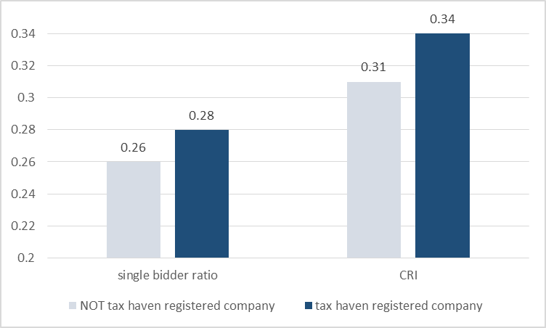
Linking supplier risks to tendering risks:
Suppliers registered in tax havens
Tax havens (Financial Secrecy Index)
  → higher corruption risks (single bidding, Corruption Risk Index)
EU28, 2009-2014
Notes:
N=28,642; differences are significant at 0.001 level
Source: Fazekas, M., & Kocsis, G. (2017). Uncovering High-Level Corruption: Cross-National Corruption Proxies Using Government Contracting Data. British Journal of Political Science. https://www.cambridge.org/core/journals/british-journal-of-political-science/article/uncovering-highlevel-corruption-crossnational-objective-corruption-risk-indicators-using-public-procurement-data/8A1742693965AA92BE4D2BA53EADFDF0

Slide 8
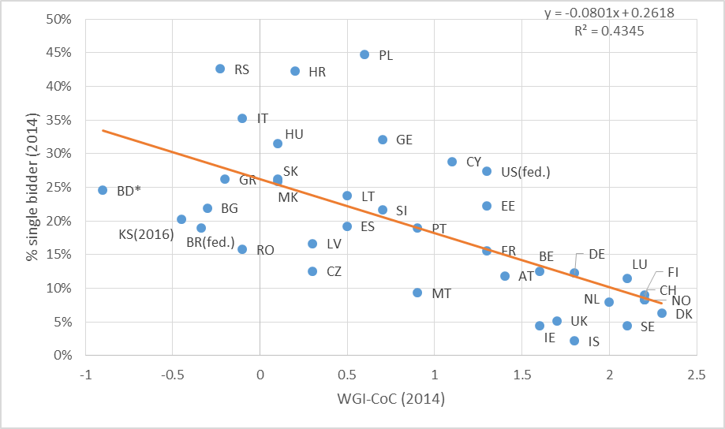
Lack of competition ~ single bidding
(on competitive markets)
Single bidding correlates with subjective indicators of corruption
Notes:
N=587,075 contracts
Source: Fazekas, M., & Kocsis, G. (2017). Uncovering High-Level Corruption: Cross-National Corruption Proxies Using Government Contracting Data. British Journal of Political Science. https://www.cambridge.org/core/journals/british-journal-of-political-science/article/uncovering-highlevel-corruption-crossnational-objective-corruption-risk-indicators-using-public-procurement-data/8A1742693965AA92BE4D2BA53EADFDF0
and own calculations using national public procurement data for outside the EU-EEA

Slide 9
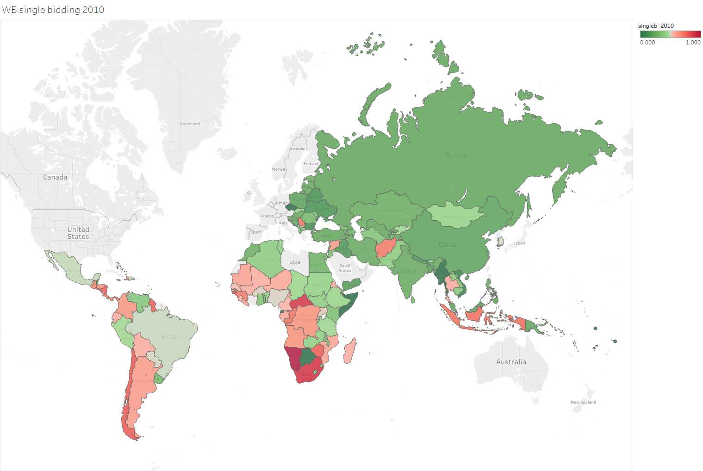
Development funding: World Bank procurement
Single bidding in World Bank funded procurement, 1998-2010
cxy

Slide 10
Agency capture ~ excessive buyer spending concentration
Agency capture correlates with businessmen perceptions of government favouritsm

Slide 11
II. Risk management tools

Slide 12
Tried tools you can use
Informing public opinion: e.g. ranking of municipalities
Tracking change over time: e.g. did corruption increase after government change in country X?
Predictive analytics and risk-based audit: e.g. predicting risky contracts
Evaluating&designing regulatory interventions: e.g. tightening transparency regulations

Slide 13
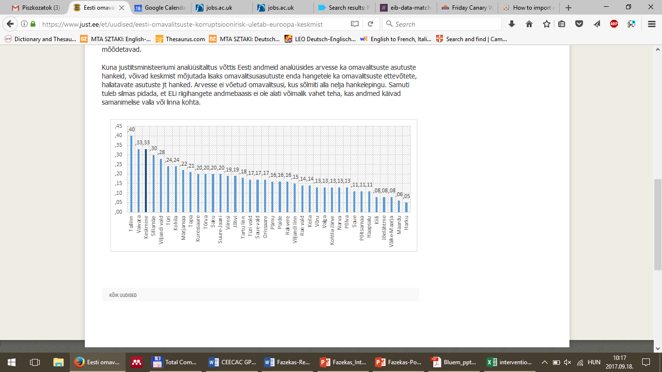
Informing public opinion: municipality rankings
Municipality ranking in Estonia: Corruption Risk Index, 2006-2015, TED data, source: Ministry of Interior of Estonia
Notes:
https://www.just.ee/et/uudised/eesti-omavalitsuste-korruptsioonirisk-uletab-euroopa-keskmist

Slide 14
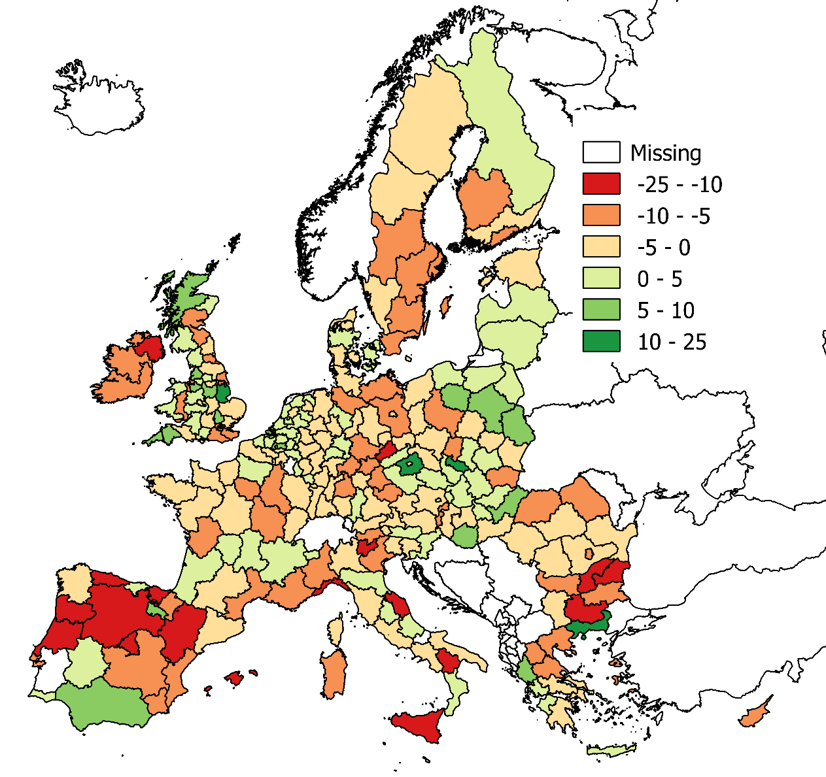
Quality of governance convergence in the EU?
NUTS2
2006-2008
vs
2013-2015

Slide 15
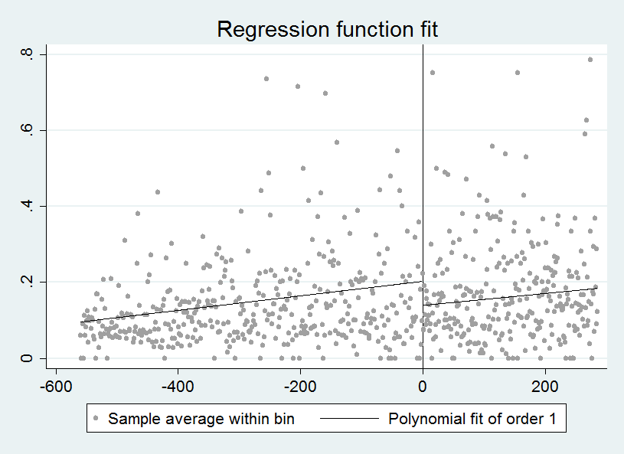
Regulatory interventions: Before/after analysis of ECJ interventions in national PP markets
Single bid
Bidder number
Local bidders

Slide 16
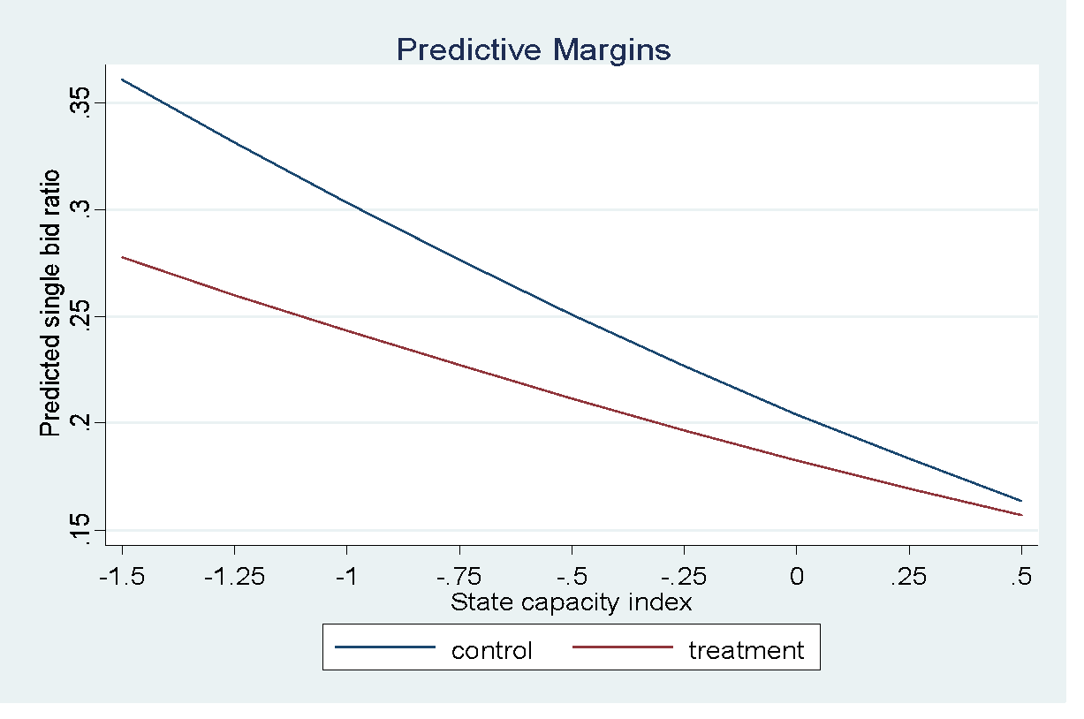
Regulatory interventions:
World Bank: 2003 GWS regulatory change
Interaction of
regulatory change &
recipient state capacity
→ to predict bidder number
Source: Dávid-Barrett, E., Fazekas, M., Hellmann, O., Márk, L. & McCorley C. (2017) Controlling Corruption in Development Aid: New Evidence from Contract-Level Data. World Development, under review.

Slide 17
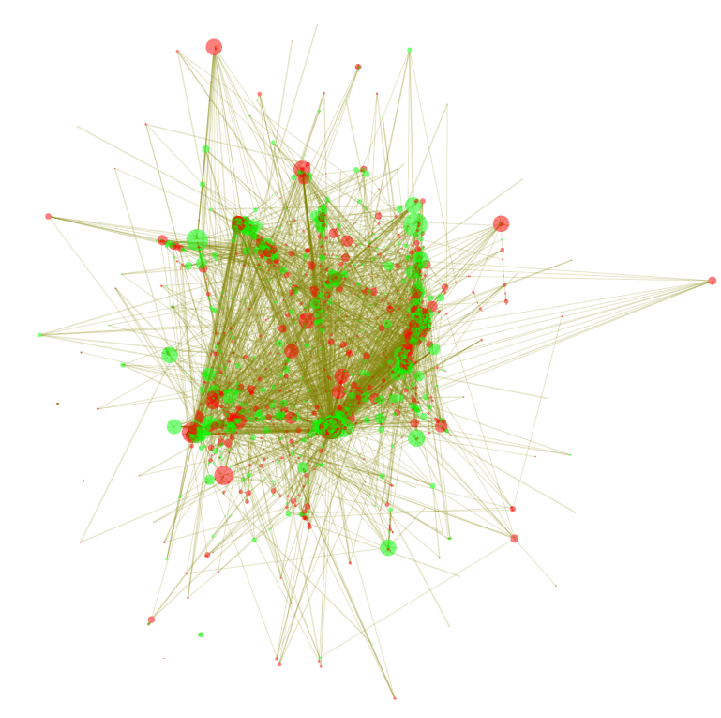
Risk mapping: Corruption risks cluster in contracting networks
Considerable clustering of risks
buyer-supplier bimodal network
N org. contract >=5 or <=50

Slide 18
What works?
Evidence overview
Notes: * using discounts compared to the original price estimate; *** % change in unite price compared to regional sugar price
Source: Fazekas, M., & Blum, J. R. (2017), Improving public procurement outcomes: review of tools and the state of evidence base, World Bank, under review

Slide 19
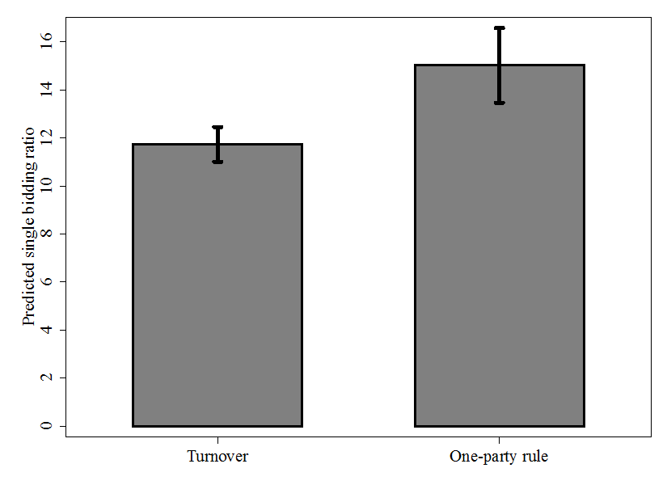
Sweden: weak electoral competition
Single bidding and local govenrment turnover since the mid 70s
+3%
Source: Rasmus Broms, Carl Dahlström, & Fazekas, M. (2017) Political competition and public procurement quality. Working Paper Series 2017:5, University of Gothenburg – QoG Institute, Gothenburg.

Slide 20
Further readings: digiwhist.eu/resources
Fazekas, M., & Kocsis, G. (2017). Uncovering High-Level Corruption: Cross-National Corruption Proxies Using Government Contracting Data. British Journal of Political Science, available online.
Rasmus Broms, Carl Dahlström, & Fazekas, M. (2017) Political competition and public procurement quality. Working Paper Series 2017:5, University of Gothenburg – QoG Institute, Gothenburg.
Charron, N., Dahlström, C., Fazekas, M., & Lapuente, V. (2017). Careers, Connections, and Corruption Risks: Investigating the impact of bureaucratic meritocracy on public procurement processes. Journal of Politics, 79(1).
Fazekas, M. & Cingolani, L. (2017), Breaking the cycle? How (not) to use political finance regulations to counter public procurement corruption. Slavonic & East European Review, 95(1).
Fazekas, M. & King, L. P. (2017). Perils of development funding? The tale of EU Funds and grand corruption in Central and Eastern Europe. Regulation and Governance, in press.
Dávid-Barrett, E., Fazekas, M., Hellmann, O., Márk, L. & McCorley C. (2017) Controlling Corruption in Development Aid: New Evidence from Contract-Level Data. World Development, under review.
Fazekas, M., Cingolani, L., & Tóth, B. (2016). A comprehensive review of objective corruption proxies in public procurement: risky actors, transactions, and vehicles of rent extraction: GTI-WP/2016:03. Government Transparency Institute. Budapest.

